Slide 1
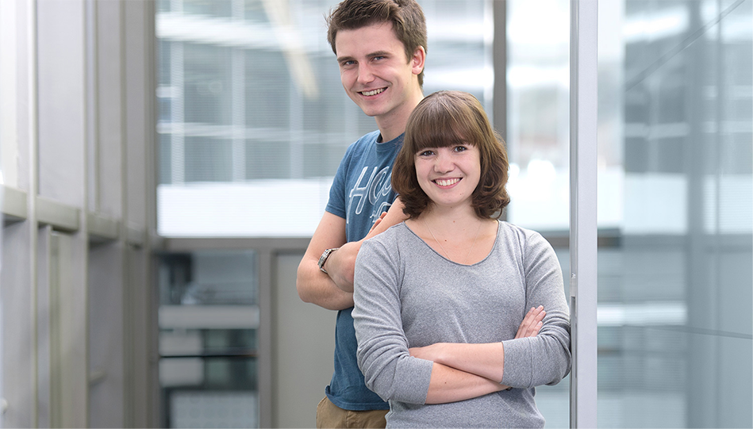
WELCOME TO
Esslingen uNIVERSITY
For people and technology

Slide 2

Esslingen UNIVERSITY of applied sciences
Image Film Student Exchange at Esslingen University
Notes:
https://www.youtube.com/watch?v=pq9HsBg-o8Y

Slide 3
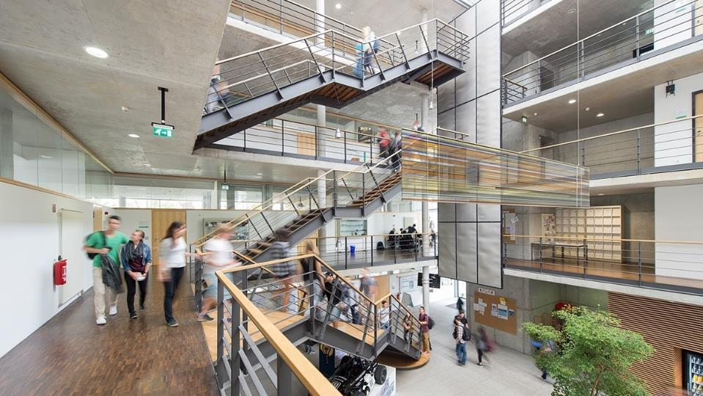
our Vision
Esslingen University –
For people and technology!
An outstanding educational environment
and a driving force for innovation
in technology, management, the social sciences and their interaction.

Slide 4
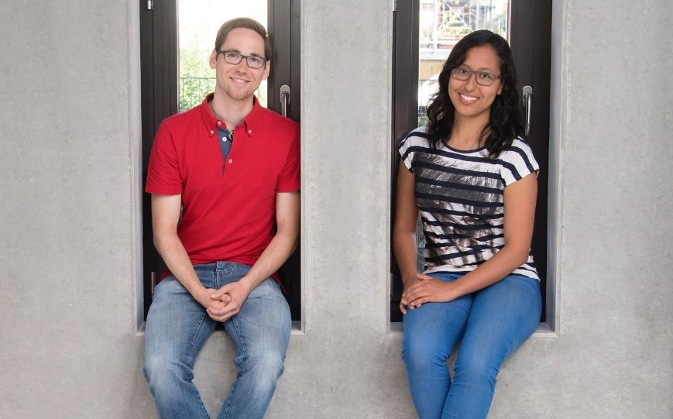
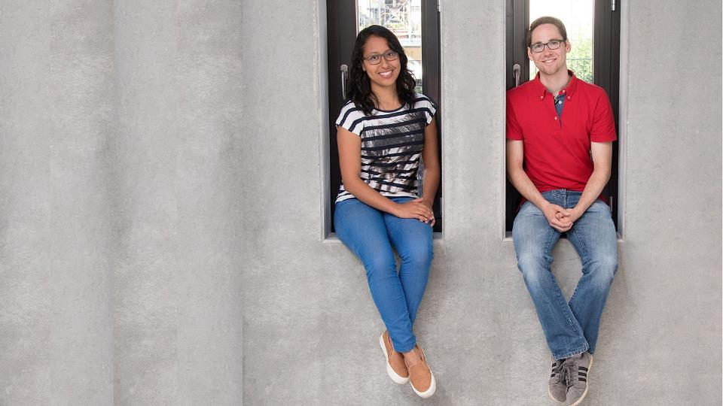
OUR TEACHING - exCellent!
    Clearly structured and accredited degree programmes
    Breadth and specialisation
    Educationally varied and modern teaching methods
    Great practical relevance through collaboration with renowned companies
    Full-time and part-time academic staff from business, industry and the social sector
    Consistently positive evaluations for our classes

Slide 5
Our research – future oriented!
Energy
Hydrogen
Smart Factory
Artificial Intelligence
Nursing Care
Social Work
Sustainable Energy Management, Intelligent Mobility and Production Systems
Internet of Things (IoT)
Social, Nursing, Health and Educational Research in the Context of Social Change
Fuel Cell
Society and Technology
Demographic Change
Digitalization
Mobility
Autonomous Systems
Society
Health
Education

Slide 6
our research – future oriented!
INSTITUTE FOR SUSTAINABLE ENERGY TECHNOLOGY AND MOBILITY (INEM)
An institute of four faculties – Science, Energy and Building Services; Mechanical and Systems Engineering; Mobility and Technology; and Management and Technology
FRAUNHOFER KEIM APPLICATION CENTRE
An application centre of the Faculty of Computer Science and Engineering and the Faculty of Mobility and Technology in collaboration with the Fraunhofer Institute for Industrial Engineering (IAO)
INSTITUTE OF AUTOMOBILE MANAGEMENT (IAM)
An institute of the Faculty of Management and Technology
INSTITUTE OF CHANGE MANAGEMENT AND INNOVATION (CMI)
An institute of the Faculty of Management and Technology
VIRTUAL AUTOMATION LAB (VAL)
A research field of the Faculty of Mechanical and Systems Engineering
RELIABILITY ENGINEERING, AND PROGNOSTICS AND HEALTH MANAGEMENT
A research field of the Faculty of Mechanical and Systems Engineering
INSTITUTE FOR HEALTH CARE AND NURSING SCIENCES (IGP)
An institute of the Faculty of Social Work, Education and Nursing Sciences
INSTITUTE FOR APPLIED RESEARCH SOCIAL WORK, EDUCATION AND NURSING SCIENCES
Current research projects of the Faculty of Social Work, Education and Nursing Sciences

Slide 7
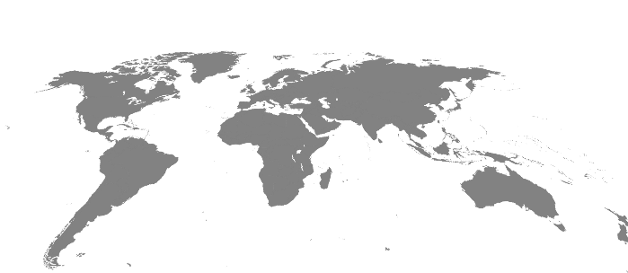

Our experience of InternationalISM
Links to 95 universities in
30 countries world-wide

Slide 8



Double Degree programmes
JAMK – Jyväskylä University of Applied Sciences Finland
Mechatronics and Electrical Engineering
IT Security
Mechanical Engineering
(Electrical Engineering)
(Automation Systems and Production Informatics)
Chinese-German
University of Applied Sciences
CDHAW, Shanghai, China
Automotive Engineering
Building Services-Energy-Environment
Mechatronics
Engineering Management
(Electrical Engineering)
(Automation Systems and Production Informatics)
(Automotive Systems)
Gannon University
USA
International Industrial Management
Software Engineering
Universidad de Zaragoza, Spanien
International Industrial Management
ITESM/Tec de Monterrey
Mexico
Mechatronics
Automation Systems and Production Informatics
Engineering Management
Mechanical Engineering
International Industrial Management

Slide 9
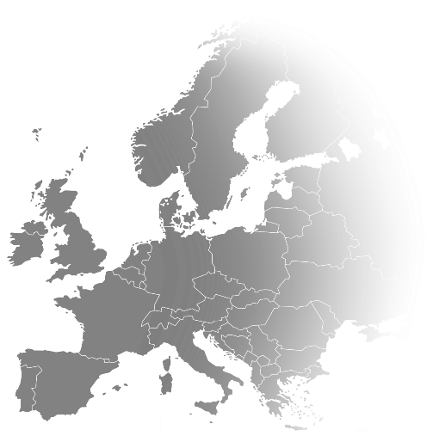
Esslingen – IN THE CENTRE OF europE
STUTTGART
MUNICH
BERLIN
LONDON
PARIS
20 min.
2.5 h
1 h
2 h
1.5 h
ESSLINGEN
City Centre
Hilltop Campus, (Flandernstraße)
GÖPPINGEN
Berlin
London
Paris
Munich
Stuttgart

Slide 10
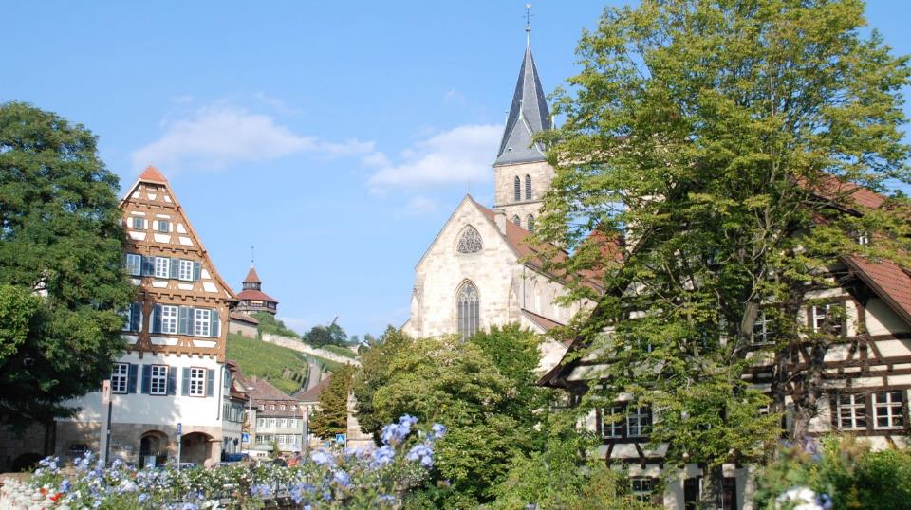
Esslingen – A LIVELY town
WITH a wealth OF Tradition
94,000 inhabitants – close to Stuttgart –
attractive economic region – home to Daimler, Porsche, Bosch, Eberspaecher and Festo

Slide 11
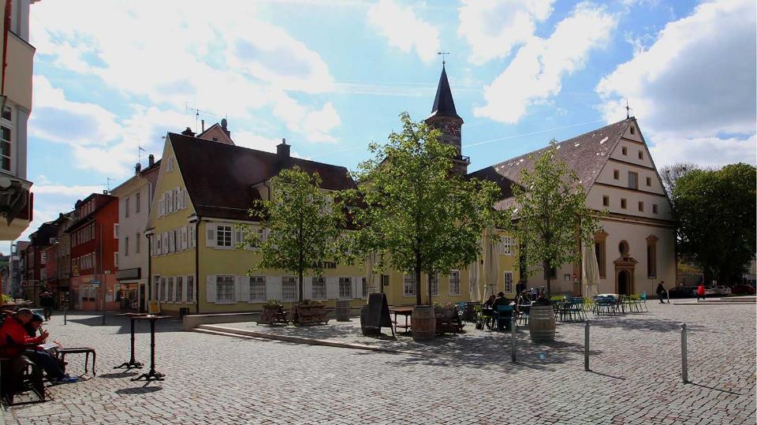
GöPpingen – Home of the hohenstaufen dynasty
58,000 inhabitants – economic region with a wealth of tradition – home to Maerklin (model trains), Bader (supplier to automotive industry), Schuler (mechanical engineering)

Slide 12
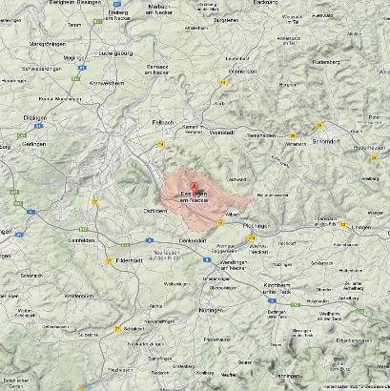
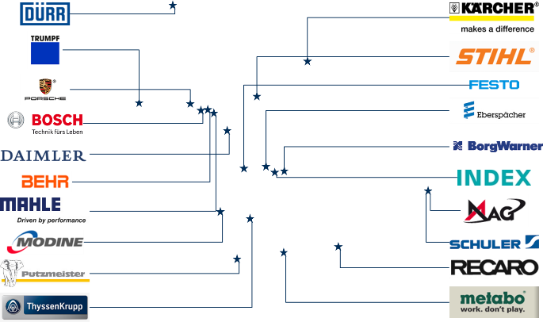
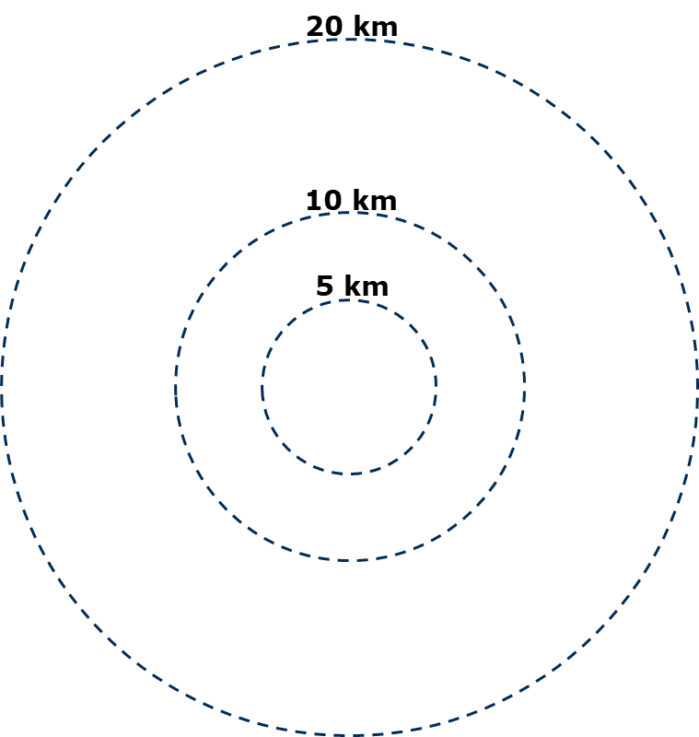
A University surroundeD by Engineering companies

Slide 13
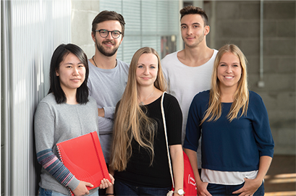
Our UNIVERSITY – facts & figures
6,500 students
6 departments
5 central academic institutions
31 Bachelor degree programmes
14 Master degree programmes
67 laboratories
27 Steinbeis transfer centres
220 full-time academic staff
440 support staff
480 part-time academic staff
Figures have been rounded. Valid as of: January 2023

Slide 14
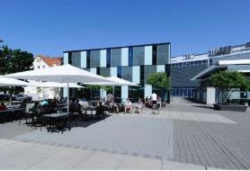
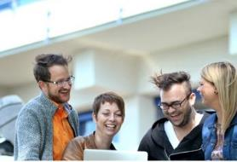
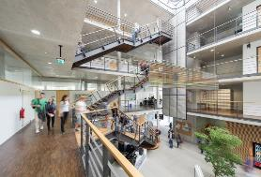
Our locations
Esslingen City Centre
Esslingen Flandernstraße
Campus Göppingen

Slide 15
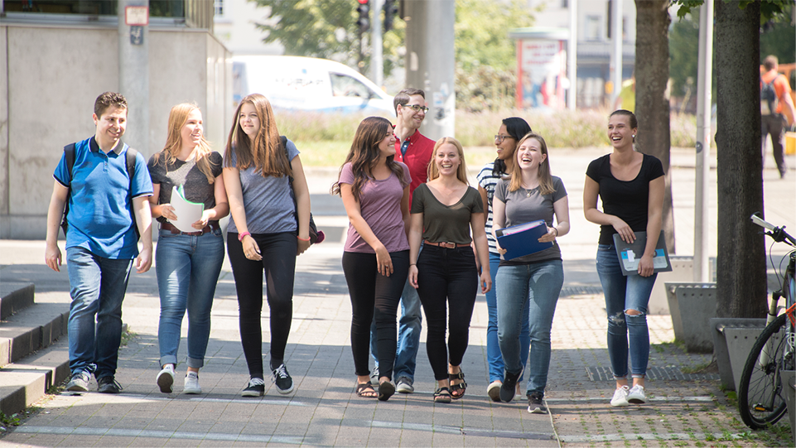
OUR FACULTIES
    Computer Science and Engineering
    Management and Technology
    Mechanical and Systems Engineering
    Mobility and Technology
    Science, Energy and Building Services
    Social Work, Education and Nursing Sciences

Slide 16
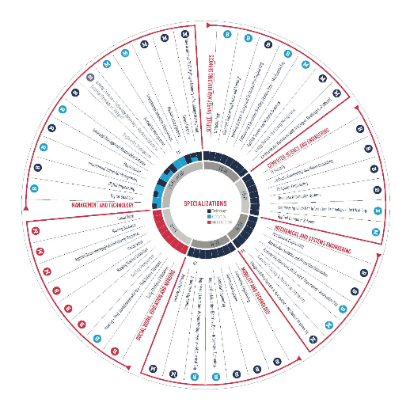

OUR bachelor DEGREE programmes
Engineering
  Automation Systems and Production Informatics
  Automotive Engineering
  Automotive Systems
  Biotechnology
  Building Services, Energy and Environmental Eng.
  Chemical Engineering/Colour and Coatings
  Computer Engineering
  Electrical Engineering
  Engineering Education with the specializations:
  Electrical Engineering Automotive Engineering,
  Computer Sciences, Mechanical Engineering,
  Building Services Engineering
  IT Security
  Mechanical Engineering
  Mechatronics
  Natural Sciences & Technology Teacher Training Programme for Secondary and Vocational Education
  Software Engineering and Media Computing
Study Plus Courses
  E-Mobility Plus
  Mechatronics Com
  Mechatronics Plus

Slide 17


OUR bachelor DEGREE programmes
Business
  Business Information Systems
  Digital Business
  Digital Engineering
  Engineering Management
  Industrial Management/Automobile Industry
  International Industrial Management
Social & Health Sciences
  Early Childhood Education
  Nursing + professional qualification
  Nursing Management
  Nursing Teacher Education
  Social Work

Slide 18

OUR Master DEGREE programmes
Engineering
  Applied Informatics
  Applied Surface and Material Sciences
  Automotive Engineering
  Automotive Systems
  Design and Development in Automotive and Mechanical Engineering
  Energy Systems and Energy Management
  Environmental Protection
  Hydrogen Economy and Technology Management
  Mechatronics/Systems Engineering
  Resource Efficiency in Mechanical Engineering

Slide 19


OUR Master DEGREE programmes
Business
  Innovation Management
  International Industrial Management (MBA)
  Smart Factory – Industry 4.0
Social & Health Sciences
  Applied Socio-Pedagogical Educational Research
  Nursing Sciences
  Social Work

Slide 20
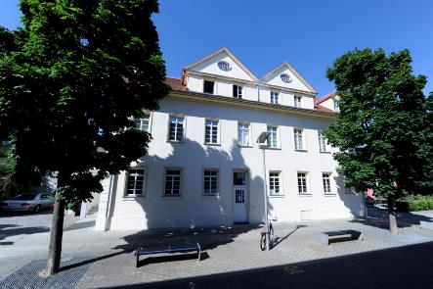
International Office – offers to partner universities
Exchange Program Erasmus/Global
Double Degree Programs
Blended Intensive Programs
Staff Training
International Weeks

Slide 21

Exchange program ERASMUS/Global - At GLance
Study together with international and German students
Semester Dates
Autumn Semester: Mid September-Mid February
Spring Semester: Beginning March-Mid July
Various options available
1 semester of studies
2 semesters of studies
1 semester of studies + 1 semester internship
Language of instruction: German or English

Slide 22
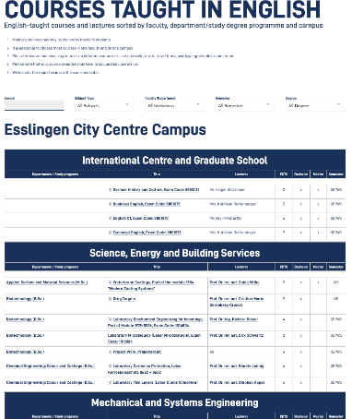
Exchange Program ERASMUS/GLOBAL
Courses taught in English in most
of the faculties www.hs-esslingen.de/etc
Many links to industry and welfare
organizations - possibilities for internships
in the 2nd semester
(DAIMLER, BOSCH, AUDI, PORSCHE)
Excellent facilities (modern workshops
and labs, etc.)

Slide 23
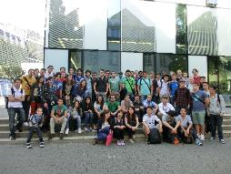
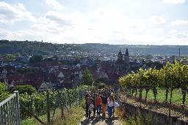
Exchange program ERASMUS/Global
Orientation week with support in all administrative steps
Academic advisor in every faculty
German language Class at different levels, free of charge
German History & Culture class to learn more
about the country and German culture
Intercultural workshops, free of charge
WhatsApp group with our student assistants and German students

Slide 24
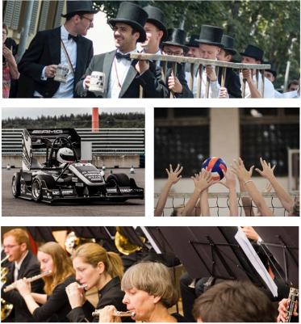
OUR CAMPUS Life
Successful: Rennstall & E-Stall
(formula student team)
Active: university sport
Musical: Pep-Band,
University Orchestra and Choir
Lively: open days, fairs, events
Special: Kandelmarsch
(Graduates’ parade)
Esslingen University.
Multifaceted. Unique.

Slide 25
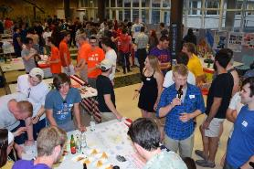
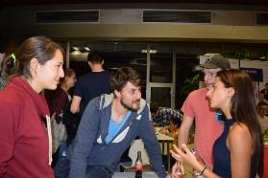
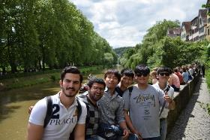
Exchange program ERASMUS/Global
International Friends Program
for German and International students with activities and trips to interesting places:
Christmas Market in Nürnberg, Heidelberg, Tübingen, Munich, Castles and more…
FREE OF CHARGE

Slide 26
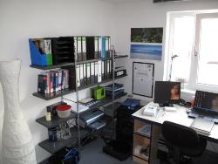
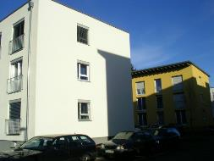
Accommodation for incoming students
Halls of residence (Student accommodation is most likely provided)
www.studierendenwerk-stuttgart.de/wohnen/wohnanlagen/rossneckar-i
| Single rooms furnished with desk, chair, shelf, wardrobe, bed
| Shared kitchen and bathroom
| ~320 € - 380 €/month
| Rent for a semester (6 months)
| Washing machine, dryer, internet access

Slide 27
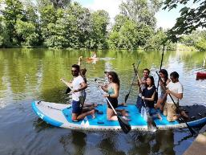
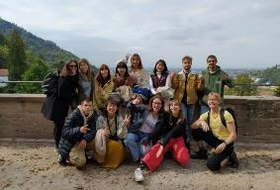
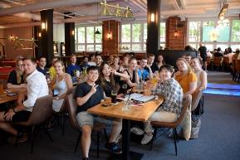
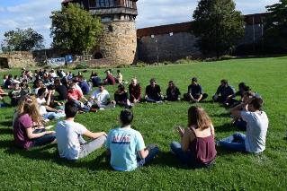
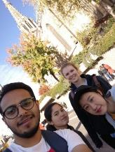
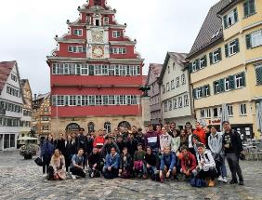
Impressions of Excursions and International Friends
Canoeing on river Neckar
Field trip to Heildelberg
Farewell event
Welcome event at Esslingen castle
City Rallye Stuttgart
City tour Esslingen

Slide 28
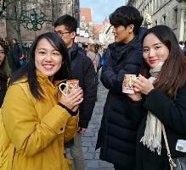
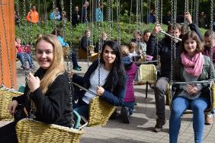
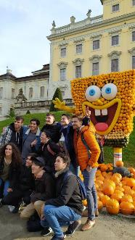
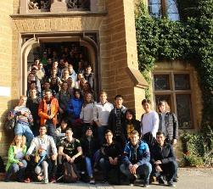
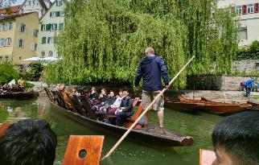
Impressions of Excursions and International Friends
Christmas market Nürnberg
Themepark Tripsdrill
Pumpkin Festival Ludwigsbug
Poke Canoeing Tübing
Castle Lichtenstein, Schwäbische Alb

Slide 29


Contact
www.hs-esslingen.de/international
Incoming Students
incoming@hs-esslingen.de
Incoming Staff
io-staffprograms@hs-esslingen.de
Blended Intensive Programs (BIP)
io-shortprograms@hs-esslingen.de

Slide 30
THANK YOU VERY MUCH FOR
YOUR ATTENTION!
Visit us at:
WWW.HS-ESSLINGEN.DE/EN

